Slide 1

Dose-Reduced Versus Standard Conditioning Followed by Allogeneic Stem Cell Transplantation in Patients With MDS or Secondary AML:
A Randomized Phase III Study of the Chronic Malignancies Working Party (EBMT)
Abstract 320
Kröger N, Brand R, Iacobelli S, Uddin R, Niederwieser D, Platzbecker U, Hübel K, Afanasyev B, Robin M, Stelljes M, Weber T, Heim D, Onida F, Dreger P, Bethge W, Gramatzki M, Guidi S, Pini M, Volin L, Kobbe G, Poire X, de Witte T

Slide 2
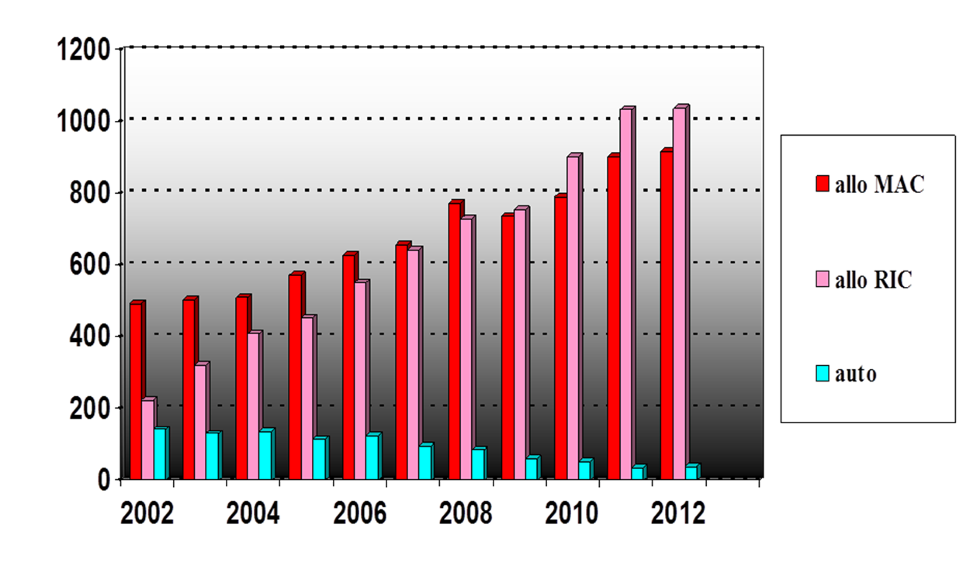
Background
While advances are being made in the biology of MDS leading to more effective therapies, such as hypomethylating agents, allogeneic transplantation is currently shown to be the most effective and curative treatment.
Dose-reduced conditioning is now more frequently used in patients with MDS because of lower conditioning-related toxicity; however, there are some concerns regarding a higher risk of relapse as shown in retrospective studies
The Chronic Malignancies Working Party (CMWP) of EBMT performed a multicenter, prospective phase III-study comparing dose-reduced versus standard conditioning followed by allogeneic stem cell transplantation from related or unrelated donors in patients with MDS or secondary AML.
1200 -
1000 -
800 -
600 -
400 -
200 -
0 -
Allo MAC
Allo RIC
Auto
2002 2004 2006 2008 2010 2012
Kröger N, et al. Blood. 2014;124: Abstract 320.

Slide 3
EBMT-Study: MDS/sAML
Randomization
ARM A
ARM B
Standard Myeloablative Conditioning (MAC)
Busulfan 12.8 mg/kg IBW iv
(or Busulfan 16 mg/kg BW po)
Cyclophosphamide
120 mg/kg BW iv
Reduced Intensity Conitioning (RIC)
Bulsulfan 6.4 mg/kg IBW iv
(or Busulfan 8 mg/kg BW po)
Fludarabine 5 x 30 mg/m² iv
Kröger N, et al. Blood. 2014;124: Abstract 320.

Slide 4
Aims of the Study
Primary endpoint
The hypothesis is that a dose-reduced conditioning will reduce the nonrelapse mortality from 40% to 20% at one year after allogeneic stem cell transplantation.
Secondary endpoints were:
Incidence of acute graft-versus-host disease
Incidence of chronic graft-versus-host disease ("limited" or "extensive")
Comparison of overall survival post-transplant at two years
Comparison of event-free survival post-transplant at two years
Cumulative incidence of relapse post-transplant at two years between both groups
Kröger N, et al. Blood. 2014;124: Abstract 320.

Slide 5
Inclusion Criteria
Disease: Cytologically proven myelodysplastic syndrome (MDS), either as:
- Refractory anemia (RA)
- Refractory anemia with ring sideroblasts (RARS)
- Refractory anemia with excess of blasts (RAEB)
- Refractory anemia with excess of blast in transformation (RAEB-T)
Chronic myelomoncytic leukemia (CMML dysplastic type)
- Or secondary acute myeloid leukemia (sAML)
Blast count <20% with or without chemotherapy at time of transplantation.
Kröger N, et al. Blood. 2014;124: Abstract 320.

Slide 6
Inclusion Criteria
Patient eligible for standard and dose-reduced conditioning
HLA-matched unrelated (HLA-A, HLA-B, HLA-DBR1) (one mismatch allowed): Age 18 - 60 years
HLA-matched related donor (HLA-A, HLA-B, HLA-DBR1) (one antigen-mismatch allowed): Age 18 - 65 years
No major organ dysfunction
Written informed consent of the patient
Kröger N, et al. Blood. 2014;124: Abstract 320.

Slide 7
Exclusion Criteria
Blasts >20% at time of transplantation
No written informed consent
Central nervous system involvement
Severe irreversible renal, hepatic, pulmonary, or cardiac disease, such as
- Total bilirubin >2 times upper the normal level
- Left ventricular ejection fraction <30%
- Creatinine clearance <30 ml/min
- DLCO <35% and/or receiving supplementary continuous oxygen
Positive serology for HIV
Pregnant or lactating women
Patients with a life expectancy of less than six months because of another debilitating disease
Serious psychiatric or psychological disorders
Kröger N, et al. Blood. 2014;124: Abstract 320.

Slide 8
Study
Study design
Prospective randomized phase III multicenter study
Start of the study: 5/2006
Accrual: 6 years
18 centers from 7 nations participated
Kröger N, et al. Blood. 2014;124: Abstract 320.

Slide 9
Statistical Consideration
Stratification factor
Applied….
Related versus unrelated
Always
Blast count <5% versus ≥5% prior to transplant
Only if in BOTH the “related” and “unrelated” strata, 4 or more patients are expected to participate
Age <45 versus ≥45 years
Only if in all 4 strata resulting from the 2 factors above, we expect at least 4 patients
Kröger N, et al. Blood. 2014;124: Abstract 320.

Slide 10
RICMAC Study
Study was prematurely stopped in 12/2012 due to slow recruitment. Analysis is based on 129 pts (2 pts did not receive SCT and were excluded)
 | Arm A (MAC) n = 62 | Arm B (RIC) n = 65
Median age <45 yrs >45 yrs | 50 yrs 15 (24%) 47 (76%) | 51 yrs 16 (25%) 49 (75%)
Blasts at SCT <5% >5% | med. 4% 45 (73%) 17 (27%) | med. 5% 35 (54%) 28 (46%)
Diagnosis MDS/CMML sAML | 53 (87%) 9 (13%) | 61 (94%) 4 (6%)
Donor HLA ident sibling or relatives Unrelated Mismatch related/unrelated | 17 (27%) 36 (58%) 9 (15%) | 16 (25%) 38 (58%) 11 (17%)
Kröger N, et al. Blood. 2014;124: Abstract 320.

Slide 11
RICMAC Study
 | Arm A (MAC) n = 62 | Arm B (RIC) n = 65
GvHD prophylaxis for unrelated ATG Alemtuzumab No antibody (CSA + MTX only) | 31 (64%) -- 15 (33%) | 30 (64%) -- 17 (36%)
IPSS at diagnosis (only MDS) low intermediate I intermediate II high | (n = 50) 2 (4%) 28 (56%) 16 (32%) 4 (8%) | (n = 52) 2 (4%) 23 (42%) 24 (43%) 6 (11%)
Chemotherapy before SCT No Yes | 39 (63%) 23 (37%) | 44 (68%) 21 (32%)
Kröger N, et al. Blood. 2014;124: Abstract 320.

Slide 12
Results
 | Arm A (MAC) n = 62 | Arm B (RIC) n = 65
Primary graft failure | 1 | 2
Leucocyte engraftment >1.0 x 10⁹/L | 14 d (10-26) | 15 d (0-25)
Platelet engraftment >20 x 10⁹/L | 14 d (9-25) | 15 d (0-25)
Acute GvHD I - IV II - IV III - IV | 31 (51%) 23 (38%) 8 (13%) | 32 (50%) 20 (33%) 8 (13%)
Chronic GvHD (total 106) no limited extensive | 18 (37%) 11(22%) 20 (41%) | 20 (35%) 15 (26%) 22 (38%)
Kröger N, et al. Blood. 2014;124: Abstract 320.

Slide 13
RICMAC Study
 | Arm A (MAC) | Arm B (RIC) | P value
NRM at 1yr at 2 yrs | 26 %(15%-37%) 28% (17%-40%) | 17% (8%-26%) 20% (9%-30%) | .17 (Gray-test)
Relapse incidence at 2 yrs | 15% (5%-25%) | 18% (8%-27%) | .51 (Gray-test)
Relapse-free survival at 2 yrs | 57% (44%-70%) | 62% (50%-75%) | .49 (log-rank)
Overall survival at 2 yrs | 62% (49%-75%) | 76% (65%-87%) | .06 (log-rank)
Kröger N, et al. Blood. 2014;124: Abstract 320.

Slide 14
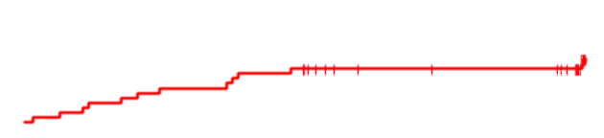
Results
Non-Relapse Mortality
1.0 –
0.8 –
0.6 –
0.4 –
0.2 –
0.0 –
MAC
RIC
P = .17
0 6 12 18 24
Time Since Randomization, Months
MAC 62 47 37 30 13
RIC 65 52 42 33 17
Kröger N, et al. Blood. 2014;124: Abstract 320.

Slide 15

Results
Relapse Incidence
1.0 –
0.8 –
0.6 –
0.4 –
0.2 –
0.0 –
MAC
RIC
P = .51
0 6 12 18 24
Time Since Randomization, Months
MAC 62 47 37 30 13
RIC 65 52 42 33 17
Kröger N, et al. Blood. 2014;124: Abstract 320.

Slide 16

Results
Relapse-Free Survival
1.0 –
0.8 –
0.6 –
0.4 –
0.2 –
0.0 –
P = .49
MAC
RIC
0 6 12 18 24
Time Since Randomization, Months
MAC 62 47 37 30 13
RIC 65 52 42 33 17
Kröger N, et al. Blood. 2014;124: Abstract 320.

Slide 17

Results
Overall Survival
1.0 –
0.8 –
0.6 –
0.4 –
0.2 –
0.0 –
P = .06
MAC
RIC
0 6 12 18 24
Time Since Randomization, Months
MAC 62 48 40 33 16
RIC 65 58 50 42 22
Kröger N, et al. Blood. 2014;124: Abstract 320.

Slide 18
RICMAC Study: Cox Model
 | OS (HR) | RFS (HR) | Relapse (HR) | NRM (HR)
RIC vs MAC | 0.42 P = .03 | 0.82 P = .48 | 1.51 P = .38 | 0.57 P = .18
Performance status 1-3 vs 0 | 2.58 P = .04 | - | - | 4.92 P = .01
Prior Chemo | - | - | 3.36 P = .01
Age >51y | - | 1.93 P = .03 | - | -
Subanalysis among cytogenetic risk on OS:
RIC vs MAC: low risk: HR: 0.14, P = .002
interm risk: HR: 0.86, P = .9
high risk: HR: 1.70, P = .39
Kröger N, et al. Blood. 2014;124: Abstract 320.

Slide 19
Conclusions
These data from the prospective, randomized EBMT study comparing RIC vs MAC in MDS patients suggest that RIC (Bu/Flu) results in at least aquivalent results in comparison to MAC (Bu/Cy)
The borderline significant improved survival of RIC (P = .06) is mainly due to an improved survival in the cytogenetic low-risk group
Longer follow-up is necessary to confirm these data
Kröger N, et al. Blood. 2014;124: Abstract 320.

